Slide 1
9th Meeting
WP 03 - Revision of the
LoD Concept
April 21st, 2015

Slide 2
Agenda (tentative)
Voting on new framework
New Framework
  UML diagram
  Proposal for official profiles (Gerd/Filip)
Next Steps
  Date for next web conference
  Presentation at Boulder Meeting (June 3rd)

Slide 3
Voting on principles of new LoD concept
Discussion phase: until 17th of April
  One comment by Filip
Voting phase: 20th – 30th of April
Entitled to vote: WP 03 participants
  Gröger, Biljecki, Kolbe, Nagel, Roensdorf, Geerling, Kraut, Häfele, Löwner, Drinkwater, Li
Procedure: Mail to WP 03 participants with text:
“I agree to the new LoD framework as described in the mail from April 2nd 2015”
Reply by answering Yes or No (in case of No with justification)
Deadline: April 30th
Bericht der AG Modellierung Plenarsitzung SIG 3D 1.6.07

Slide 4
New LoD Framework: Clarification
There are some minimum requirements for all profiles (e.g., a wall SURFACE can not be represented by a solid).
In the CityGML 3.0 specification, a set of profiles (official profiles) will be defined (proposal be Gerd/Filip)
Users can either
  define own profiles (independent from the official ones)
  use the official profiles, or
  refine the officials profiles (adding constraints, ...)
Bericht der AG Modellierung Plenarsitzung SIG 3D 1.6.07

Slide 5
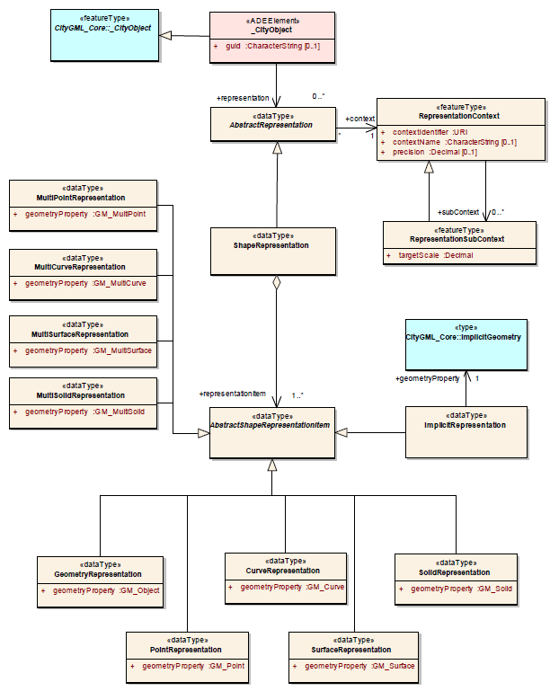
UML diagram

Slide 6
UML diagram: discussion Items
Are SubContexts necessary? UseCases?
Are items necessary? Use cases?
  LoD2SolidGeometry / LoD2MultiSurfaceGeometry?
  What about LoD0: both roofEdge and footprint are surfaces?
Instance document? Complexity?
All representations in UML diagram are geometrical. Why isn't it called GeometryRepresentation?
Relation to all CityObjects? Or to subset of CityObjects with geometry?
Bericht der AG Modellierung Plenarsitzung SIG 3D 1.6.07

